Slide 1
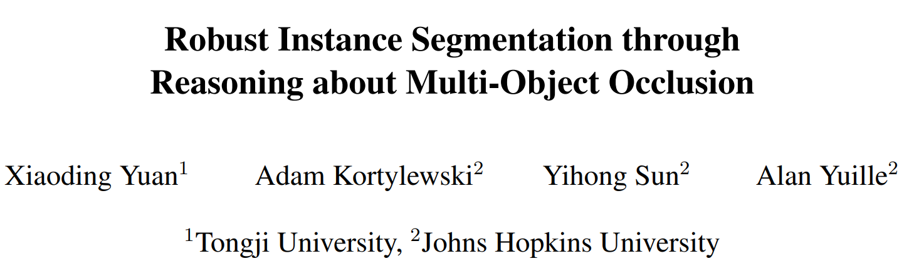
arXiv:2012.02107v1 [cs.CV] 3 Dec 2020
Speaker：Li Hao

Slide 2
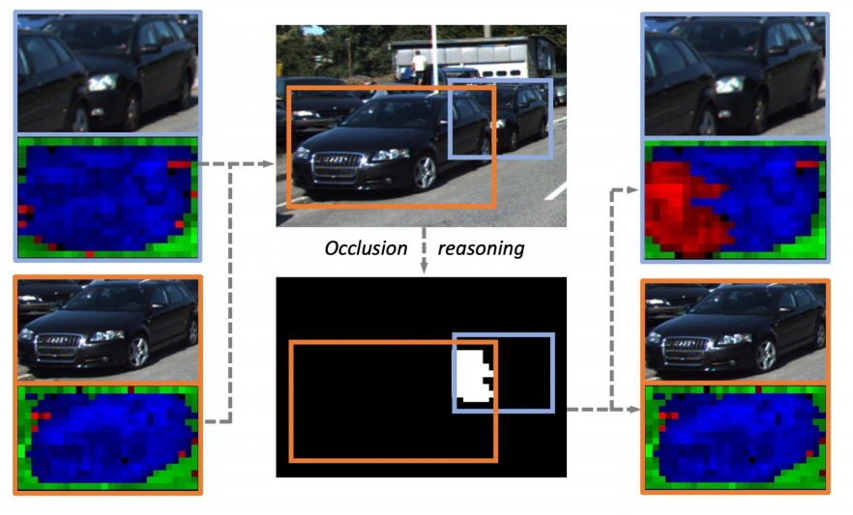
Introduction& Motivation
当图像中包含多个物体部分遮挡时用神经网络分析复杂场景是具有挑战性，与人类相比，深度网络在识别部分遮挡物体的方面鲁棒性较差，主要困难来源于物体顺序和位置的组合变异性以及场景中可能存在已知或未知的物体。而现有的图像分析方法大多是独立处理对象，没有考虑到附近对象的相对遮挡。

Slide 3
Introduction& Motivation
目前解决遮挡问题的一种方法是数据增强，虽然鲁棒性增强了，但是部分遮挡对象的分类性能差。
合成深度网络（compositional deep networks or CompositionalNets）比数据增强更具有鲁棒性，但是其也是独立地对待图中对象，没有明确使用对象间的相互关系。

Slide 4
Contributions
本文有以下贡献：
1）提出了一种多物体实例分割的网络，其基于CompositionalNets，通过多物体遮挡推理增强了对遮挡的鲁棒性，并且只需要bounding box来进行监督。
2）提出了一个Occlusion Reasoning Module (ORM)，可以在多个物体的生成模型中进行有效的推理，能检测到错误的前馈（ feed-forward ）预测，并利用通过推理对象的遮挡顺序来进行更正。
3）在KINS 数据集中，实现了遮挡下实例分割的state-of-the-art。

Slide 5

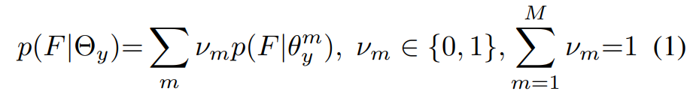
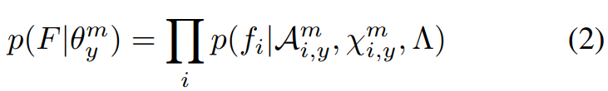



Method — CompNets for Single Objects
the fully connected classification head is replaced with a differentiable compositional model
M ：the number of mixtures of compositional models per object category

Slide 6
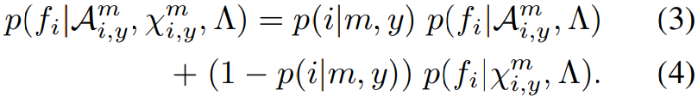





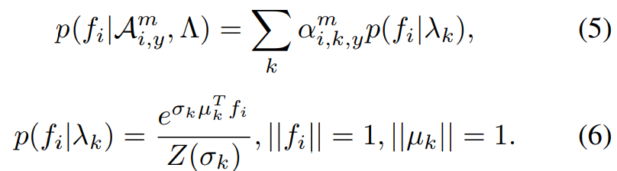
Method — CompNets for Single Objects
feature likelihood is defined as composition of a foreground and a context likelihood
Foreground 似然
context 似然
the parameters of von-Mises-Fisher distributions

Slide 7



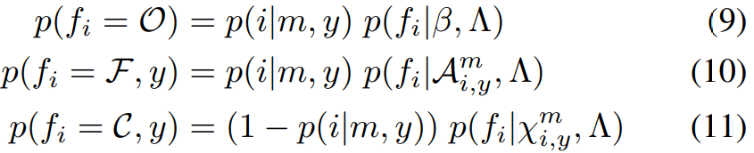
Method — CompNets for Single Objects
用了一个outlier模型来增强其对部分遮挡的鲁棒性：
outlier模型：
比较模型的似然项可以实现实例分割。
occlusion O
foreground F
context C

Slide 8
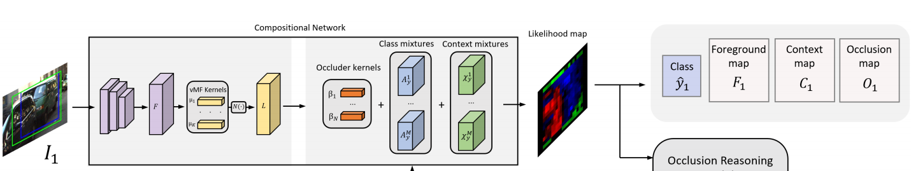
Method — CompNets for Single Objects

Slide 9
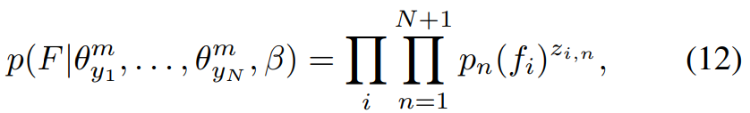



Method — CompNets for Multiple Objects
assuming independence between objects neglects the relations between them and leads to inconsistencies in the segmentation results.
Maximizing the model likelihood is difficult （because it involves multiple objects and the visibility at each pixel ，depends on the visibility of the neighboring pixels）

Slide 10
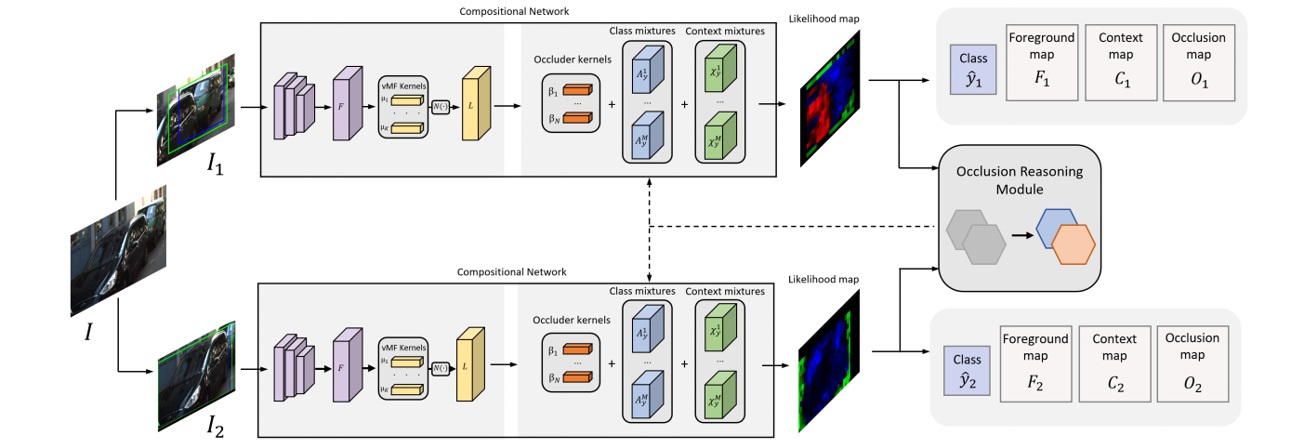
Proposed network architecture

Slide 11
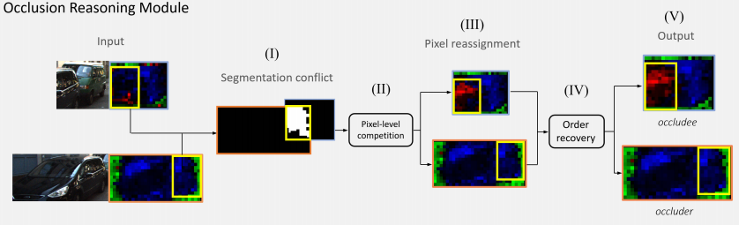
Pipeline — Reasoning about Multi-Object Occlusion

Slide 12
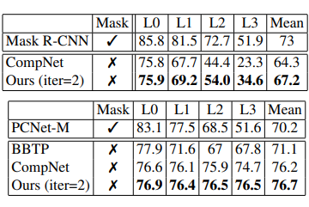
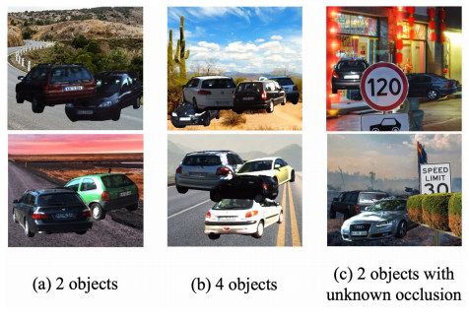
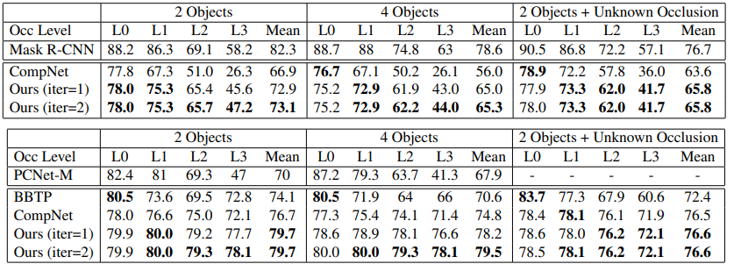
Experiments
Modal and amodal instance segmentation
on the KINS
on occlusion challenge

Slide 13
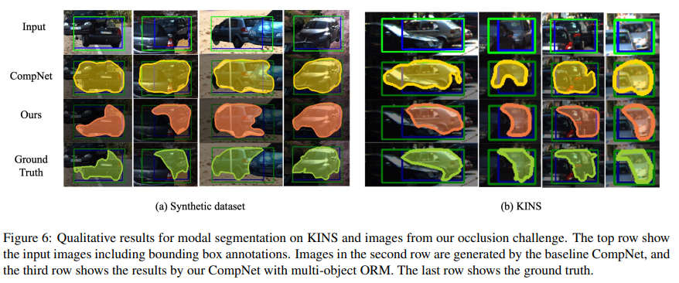
Experiments

Slide 14

Experiments
Ablation study（ verify the effectiveness of the order recovery ）

Slide 15
Thanks!

